Slide 1
Southern Water Corp – Technical Presentation
Date: 07-25-2020
Presenter: Xiangning Bu

Slide 2

Rising in cost-to-produce caused by higher water demand and maintenance events have placed upward pressure on SW profit margins requiring either increase production or proactive maintenance strategies
Increase water production leading to instability of desalination plants
Due to the high demand, particular signatures around a number of pumps indicative of system failure
With incoming of the maintenance, water production is expected to decrease
The maintenance event reduced water production by 1968 ML
Maintenance events and less water production place pressure on profit margins
With elevated COGS and operation expenses, causing a $38.0 production cost($/ML) increase for the 2014-2015 period

Slide 3
Instability of desalination plants could be alleviated through the proactive identification of pump failure.
Identify a particular or sequence of variables that correlated to pump failure.
Analysis of the data from one unit and looking for correlations between abnormal indicators and pump failiure
Build up an equation to represent the correlations between variables and pump failure
Model the failure for one pump and scale this our for all pumps

Slide 4
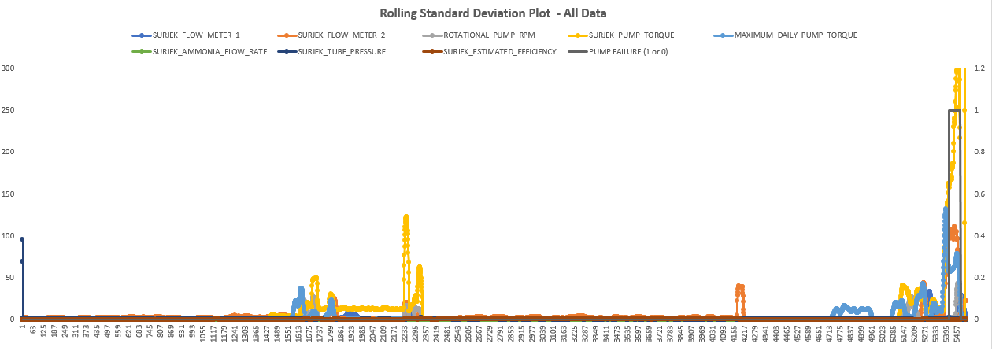
Through utilization of descriptive and inferential statistics, several key variables strongly correlated with the pump failure, enabling development of a multivariate equation capable of proactively identifying abnormal pump behavior.
Regression variables: During the Failure Window (i.e. Failure Mode = 1 the Pump Torque, Surjek Flow Meter 2 and Maximum Daily Pump Torque seem to 'move' in tandem with the Pump Failure. To a lesser extent, Pump RPM is also seen to peak up slightly in relation to the Failure Event.
Failure Behavior: the Pump Torque, Surjek Flow Meter 2 and Maximum Daily Pump Torque dramatically increased when the failure mode is 1.

Slide 5
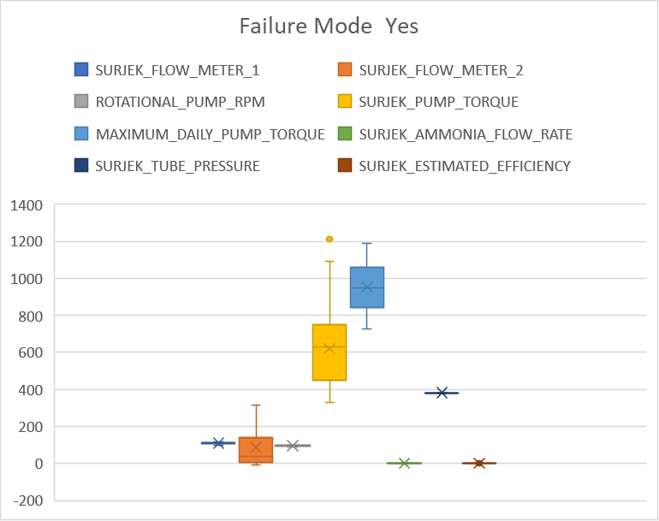
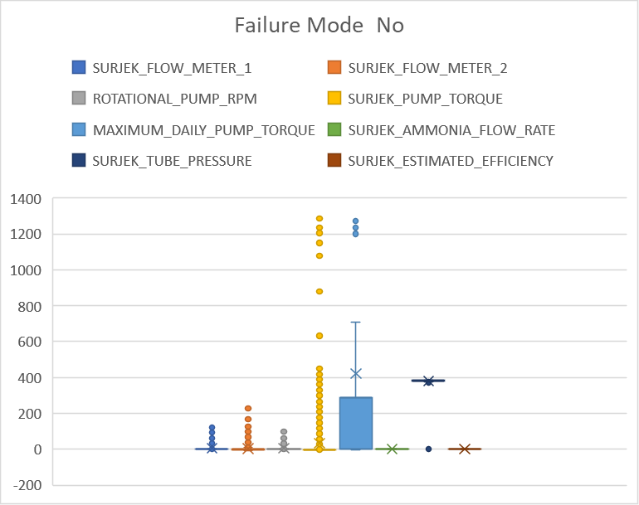
Splitting the data into two respective sets, indicating normal behavior and abnormal behavior, yielded 5 particular signatures (Surjek_Flow_Meter1, Surjek_Flow_Meter2, Rotational_Pump_RPM, Surjek_pump_Torque, Maximum_Daily_Pump_Torque ) are closely with pump failure.

Slide 6
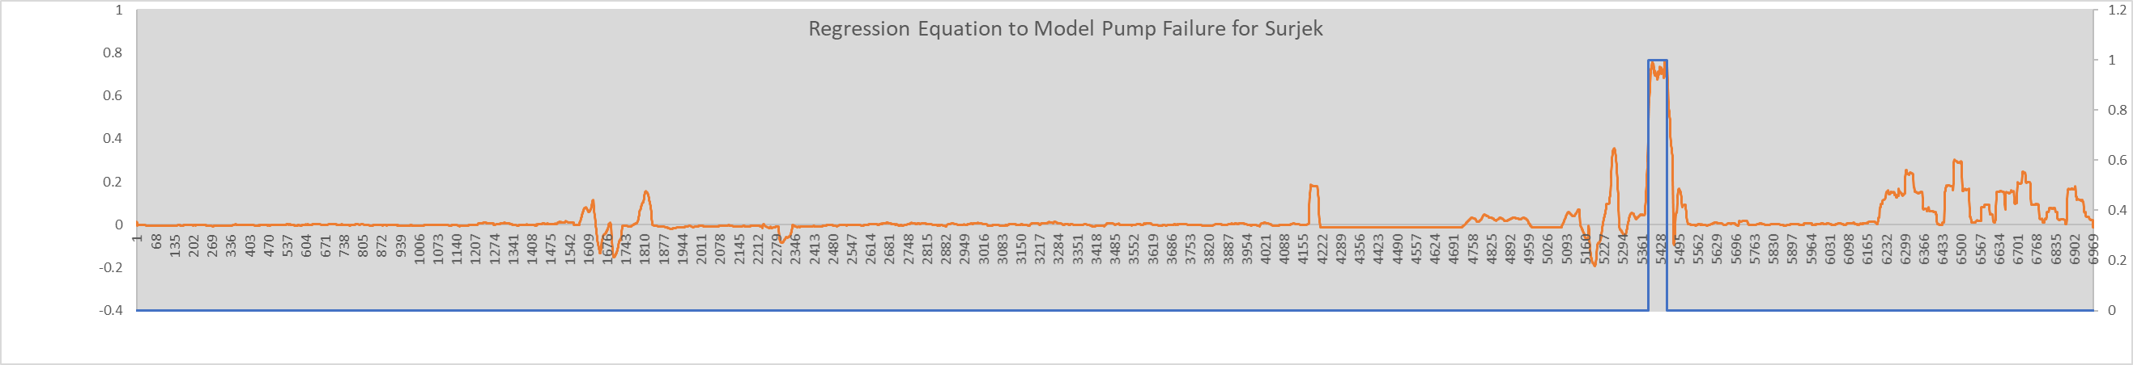
Using the values from correlation analysis, to build the regressive equation that enabled us to create a unique failure signature for an individual pump.
Expanding on initial insights, this further reinforced with Pearson correlation highlighting Surjek_Flow_Meter1, Surjek_Flow_Meter2, Rotational_Pump_RPM, Surjek_pump_Torque are correlated with pump failure.
Pre-Failure signature may indicate failures operators may have missed

